Slide 1

Patrol Rifle
Instructor Lesson Plan
Municipal Police Training Committee | Recruit Academy
Based on the MPTC Patrol Rifle Instructor Manual (Draft, March 2021)
Notes:
Title slide. Source: MPTC Patrol Rifle Instructor Manual, draft dated 15 March 2021.

Slide 2



Course Roadmap: Three Sessions
Session 1: Foundations
Session 2: Operations
Session 3: Practical
Safety and administration
History and mission of the patrol rifle
Basic function: nomenclature, cycle of operation, conditions of carry
Sights and zeroing
Handling: carry conditions, loading, downloading, transport
Field stripping, cleaning and function check
Malfunctions and immediate action
Slings, magazines, lights and optics
Dry fire stations: Groups I, II and III
Live fire fundamentals and positions
Movement, safety circle and cover
MPTC qualification course
Notes:
The course runs in three sessions that build from the basics to the practical. Session 1 lays the foundation in the classroom. Session 2 covers how the rifle is operated, maintained and cleared. Session 3 puts it all into practice in dry fire stations and live fire on the range, ending with qualification.

Slide 3
Foundations
SESSION 1 OF 3
Safety and administration first, then where the patrol rifle came from, how it works and how to sight it in.
PART 1
Safety and Admin
PART 2
History and Mission
PART 3
Basic Function
PART 4
Sights and Zeroing
Notes:
Session 1 is classroom based. Start with introductions and every safety protocol before any rifle comes out of its case.

Slide 4




Introductions
Firearms Staff
Lead Instructor
Introduce the full team running the course
Reviews safety rules and the Incident Action Plan with everyone
Safety Officers
Assistant Instructors
Visibly identified in safety vests
Support small group stations and coaching
Notes:
Introduce the firearms staff and explain each role so students know who to look to during classroom drills and on the range.

Slide 5
Classroom Safety Protocols
Chamber flags required
Bright orange or yellow so there is no question the chamber is SAFE and EMPTY
1
Rifles secured in cases
Trigger locks or chamber locks. Locked hard cases are fine with flags visible when opened
2
Designated Safety Personnel
Wear safety vests. Their sole job is to observe, act immediately and report violations
3
Students checked for live ammunition
Pistol, rifle and on their person
4
Instructors checked for live ammunition
Sidearms secured during classroom exercises
5
Notes:
Instructors will be checked the same as students. If an instructor has a sidearm on, it must be secured during the classroom setting when performing any exercises.

Slide 6
Classroom Safety Protocols (continued)
One way in, one way out
Safety personnel funnel everyone through a single checkpoint and own overall safety of the classroom and range
6
Incident Action Plan always in place
For all firearms training, dry or live, reviewed with all personnel by the lead instructor
7
Signed safety rules
Lead instructor reviews the rules and every student signs
8
Designated loading and unloading areas
Chosen in each room used for dry drills
9
Notes:
Lead instructor reviews all safety rules with the class and has each individual sign that they understand and agree to the rules.

Slide 7
Four Cardinal Rules of Firearms Safety
TREAT ALL WEAPONS AS LOADED WEAPONS
1
2
3
4
All firearms are always considered loaded until physically and visually checked. Even then, treat them as loaded.
The muzzle NEVER points at anything you are not willing to destroy. Keep it in a safe direction so an unintentional discharge would not cause death or injury.
Finger off the trigger and weapon on safe until the weapon is on target and the decision to fire has been made. Off target, off trigger.
Be sure of your target AND what is beyond it.
Notes:
These four rules apply to all firearms in all situations and carry into every weapon platform. Emphasize: Treat all weapons as loaded weapons.

Slide 8

Chamber Flags and Additional Safety Protocols
Chamber Flags
Additional Protocols
Used whenever rifles are in racks or in cases
Used during classroom drills to demonstrate shooting positions
Used during the transition drill in the classroom
The Laser Rule: treat the firearm as a laser that destroys everything in its path
Hearing and eye protection for everyone on the range. Foam plugs plus muffs strongly recommended for rifle
Eye protection must have side shields
Ball cap required. Worn backwards it helps prevent hot brass injury
Notes:
Chamber flags can also be used during classroom drills such as explaining shooting positions and the transition drill. Recommend foam earplugs in addition to over the ear muffs for rifle shooters.

Slide 9
Historical Background
1966
1986
1997
1999
2017
Aug 1
University of Texas Clock Tower shootings
Apr 11
Miami shootout with federal agents
Feb 28
North Hollywood bank shootout with police
Apr 20
Columbine High School, first national news coverage of an active shooter
Las Vegas shooting and many others
Late 1800s: lever action rifles rode in the sheriff's saddle scabbard. The rifle waned in the early 20th century until these incidents.
Notes:
The patrol rifle has been in use since the late 1800s. It was common to see a lever action rifle in the sheriff's saddle scabbard in the old west. During the early 20th century the rifle waned in popularity. These incidents changed that, with many more up to the Las Vegas shooting in 2017.

Slide 10


Why the Patrol Rifle
Conventional Wisdom
Two Realities Changed It
Rifle used since the advent of rural policing
Pistol and shotgun considered adequate in cities
Rifle seen as too powerful with over penetration concerns
Used mainly for containment and perimeter security in standoffs
Average officer struggles with pistol accuracy beyond 15 yards, and hit ratios drop under life or death stress
Criminals increasingly carry high powered weapons that engage officers from distances where pistols are ineffective
Notes:
The rifle in police hands is not new. It has been used since the start of rural policing. In cities, the pistol and shotgun were long considered adequate. Officers did not have to close distance to a threat when armed with a rifle.

Slide 11



Rifle Compared to Pistol and Shotgun
Shotgun Buckshot
Shotgun Slug
5.56mm NATO (.223 Rem)
More forgiving with some ammunition
Challenging beyond 15 yards
Spread can exceed a torso, risking misses and innocent persons
Longer range and more accuracy
No shot spread
Greater penetration than a rifle round
Penetrates fewer walls than service pistol rounds or 12 gauge slugs
Accuracy at distance far exceeds pistol or shotgun
Notes:
Buckshot spread at distance can be larger than a torso, creating risk of missing the target and hitting innocent persons.

Slide 12

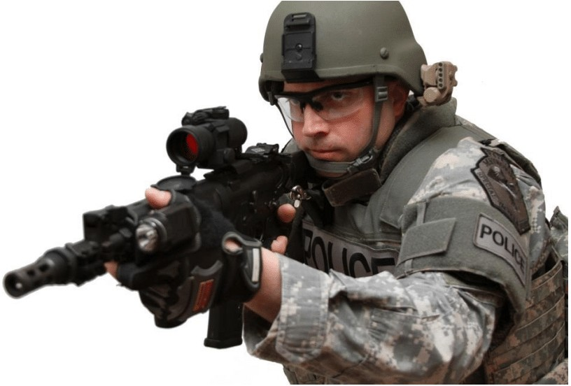



The Rifle Is a Superior Tool
Standoff from the threat
Advance to the threat with confidence when the situation requires
Good terminal ballistics and stopping power
Penetrates soft body armor
Larger magazine capacity than the service pistol or shotgun

Slide 13
Mission: A Force Multiplier
100+
3,000
3 to 4x
yards of controlled fire
feet per second impact velocity
the standoff distance of a pistol
Longer sight radius gives more accurate shots than the handgun
Greater range than shotgun slugs or buckshot
5.56mm / .223 ammunition defeats soft body armor
Effective shot placement. Distance is our friend and gives us time to react and decide
Notes:
The advantages of the rifle let officers deal effectively with multiple adversaries at longer distance without the disadvantages of being armed only with a handgun. The hydrostatic shock from a round impacting at 3,000 feet per second causes far more damage than pistol caliber ammunition.

Slide 14
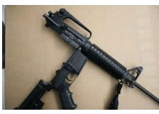
Nomenclature: Stock, Barrel and Upper Receiver
Stock
Barrel
Upper Receiver
Fixed or folding
Collapsible or adjustable
Butt plate
Sling swivels
Chamber
Front sight
Muzzle
Muzzle brake
Forward assist
Charging handle
Dust cover
Picatinny rail
Carry handle
Rear sight
Notes:
Go through the parts and system of the rifle using this presentation and a training rifle.

Slide 15
Nomenclature: Lower Receiver, BCG, Magazine
Lower Receiver Group
Bolt Carrier Group
Magazine
Grip
Selector safety switch
Trigger group: sear, disconnector, hammer
Trigger guard
Magazine well and release button
Bolt release and locking paddle
Front and rear takedown pins
Bolt carrier
Bolt
Extractor
Firing pin
Locking lug
Firing pin retainer
Follower
Follower spring
Bottom plate

Slide 16
Cycle of Operation
FEED
FIRE
EXTRACT
EJECT
Cartridge moves from the magazine to the chamber
Firing pin strikes the primer and the powder combusts
Cartridge case is removed from the chamber
Cartridge case is thrown from the receiver
Every malfunction falls into one of these four phases
Notes:
Common to all rifles, gas, piston or recoil operated. The weapon must FEED before it can FIRE, FIRE before it can EXTRACT and EXTRACT before it can EJECT. Malfunctions are classified into these same categories later in the course.

Slide 17
The Four Conditions of Carry
 | Safe / Storage | Transport | Tactical | Fire
Action | OPEN | CLOSED | CLOSED | CLOSED
Chamber | EMPTY | EMPTY | LOADED | LOADED
Magazine | NONE | LOADED | LOADED | LOADED
Safety | ON | ON | ON | OFF
Used for | Long term storage or repair | Cruiser ready storage | Deployed for a possible threat | Decision to shoot made, sights on target
Cruiser Ready (Transport) is the recommended and most common method for storing the rifle in the cruiser.
Notes:
Safe or Storage: used for extended storage, for example a rifle out of service for repair or removed from a cruiser. Transport: ready for use but cannot fire if bounced around in a crash or pothole. Tactical: rifle removed from the cruiser with intent to use it in a deadly force situation. Fire: only when the conscious decision to shoot has been made and sights are on target.

Slide 18
Front Sight
Most common: a raised post, similar to a service pistol
Centered vertically and horizontally in the rear sight opening
Longer sight radius means the post can be thinner than a pistol's
Thinner post lets in more light for greater accuracy and precision
Protective steel ears on AR15 / M16 style rifles
Most LE patrol rifles have a front sight adjustable for elevation
Low light options: white stripe or tritium night sights
Notes:
Explain sight radius to students: the distance between the sights. Common designs include a raised pair of protective steel ears as on the AR15 / M16. Other designs are covered in the manual.

Slide 19
Front Sight Adjustment
The post screws into the triangular AR15 front sight assembly
Once elevation zero is set at the front sight, do not adjust elevation at the rear sight. That runs counter to the rifle's design.
1
A spring loaded detent locks into notches on the post's base
2
Depress the detent, then turn the post in or out
3
Turning in or out lowers or raises the sight, opposite of rear sight elevation
4
No tool? Use the tip of a .223 round to press the detent and turn the base
5
Confirm the detent seats in a notch when finished
6
Notes:
The front sight is designed to be adjusted and set once proper elevation is found during initial zeroing. If no sight tool is available, the .223 round can be used. The rifle was designed to be adjusted with it in the field.

Slide 20


Rear Sights
Open Sights
Aperture (Peep) Sights: Most Common in LE
Also called tangent or notch sights
Same equal height, equal light principles as the pistol
Front sight focus
A disc with a centered hole you look through
Small aperture: precision shooting
Large aperture or ghost ring: close range, low light, faster sight acquisition
Many rifles let you select between apertures
Notes:
Sighting principles such as equal height equal light and front sight focus are the same as with the service pistol, regardless of rear sight type.

Slide 21


Rear Sight Adjustment and the A2 Drums
General Rules
AR Type (A2) Rear Sight
Some rear sights adjust windage only, others windage and elevation
Move the rear sight in the direction you want the bullet to move
How far impact moves depends on target distance and sight design
Original M16 / AR15: windage only, inside the carry handle
Today: dual apertures, one much larger
Right drum adjusts windage
Bottom drum is bullet drop compensation, used only AFTER the rifle is zeroed
Notes:
Talk about bullet drop only in general terms. The drop of the .223 over distance was determined by ballistics software and built into the elevation drum. Numbers on the drum match the range: 4 is 400 meters, 5 is 500 meters.

Slide 22
Zeroing and Mechanical Zero (AR)
Zero distance: 25 to 300 yards, set by the department firearms instructor based on the ranges officers may need to deploy the rifle.
1
Center the sights within their range of adjustment
2
Align the windage indicator on the 0 to 2 aperture with the scale center line
3
Rotate the elevation knob down until 8/3 (300 yards) aligns with the receiver mark
4
Raise the large 0 to 200 aperture and center it in the housing with the windage drum
5
Turn the front post until its base is flush with the top of the sight post well
Notes:
Zeroing, also called sighting in, aligns the sights with the bullet trajectory at a specific distance. Set mechanical zero before attempting a battle sight zero. It makes zeroing easier and quicker.

Slide 23
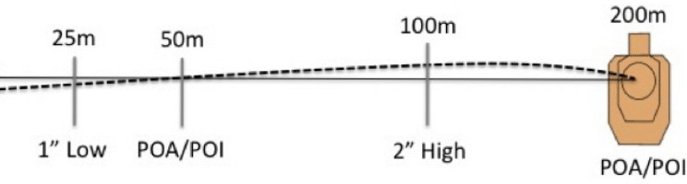
The 50m / 200m Zero
25m
1 inch low
50m
POA = POI
100m
2 inches high
200m
POA = POI
Notes:
Draw this out on the whiteboard. The bullet crosses the line of sight at 50 meters, rises about 2 inches high near 100 meters and crosses the line of sight again at 200 meters. At 25 meters impact is about 1 inch low.

Slide 24
Battle Sight Zero: AR15 / M16 (.223)
1
Start from mechanical zero
Zero elevation at the FRONT sight only. Leave the A2 rear elevation drum on 8/3. MPTC qualification: zeroed at the 50 yard line, point of aim equals point of impact.
2
Stable supported prone position
Same sight picture and cheek weld every shot
3
Fire a 3 round group at the zero distance
4
Find the group center and compare to point of aim
5
Elevation: adjust the front sight post
Screw in to raise impact, out to lower impact
6
Windage: adjust the rear sight drum
Move the rear sight toward where you want impact to go
7
Confirm until point of aim equals point of impact
Notes:
Picks up from mechanical zero on the AR15 / M16 platform in .223 / 5.56mm. Use the department zero distance. The MPTC qualification course expects rifles zeroed at the 50 yard line with point of aim equal to point of impact. Front sight: screwing the post in (clockwise) lowers the post and raises the point of impact. Screwing it out lowers the point of impact. Rear sight: move the rear sight in the direction you want the bullet to move. Do not use the A2 rear elevation drum to zero. It stays on 8/3 and is only used for bullet drop compensation after the rifle is zeroed.

Slide 25
Operations
SESSION 2 OF 3
How the rifle is handled, maintained and kept running: carry conditions, loading and downloading, field stripping and cleaning, malfunctions and equipment.
PART 1
Handling the Rifle
PART 2
Maintenance
PART 3
Malfunctions
PART 4
Equipment
Notes:
Session 2 builds on the nomenclature and conditions of carry from Session 1. Demonstrate each procedure with dummy rounds only.

Slide 26
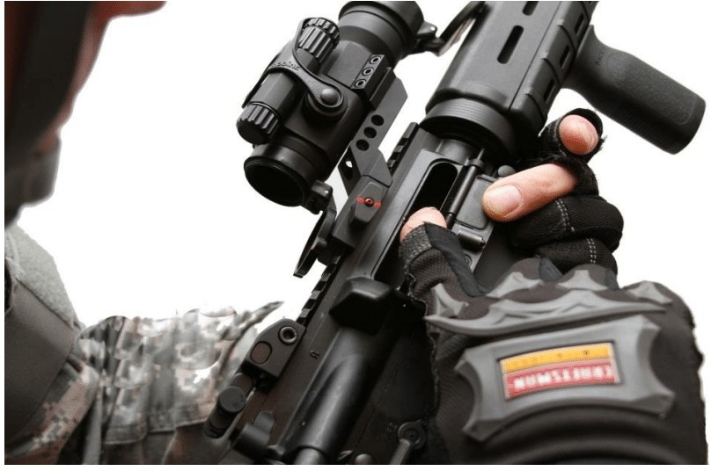
3 Point Safety Check
1
Remove the magazine
2
Lock the bolt to the rear
3
Conduct the 3 point check
Chamber, ejection port, magazine well
4
Cycle the bolt 3 times
5
Close the bolt
6
Ensure the safety is ON
The weapon is now CLEAR and SAFE. To make it cruiser transport ready, insert a full magazine WITHOUT chambering a round.
Notes:
This is the standard clearing procedure used every time the deck calls for a clear and safe rifle. Keep the muzzle in a safe direction throughout. The 3 points are the chamber, the ejection port and the magazine well. Check each one visually and physically. When finished the weapon is clear and safe. To make it cruiser (transport) ready, insert a full magazine without chambering a round. Demonstration tips: show the magazine release and stress not riding it during trigger finger management, show both ways to release the bolt (charging handle and bolt release paddle), and show every position the selector indexes on: Safe, Semi, Auto, Burst.

Slide 27


Transport and Tactical Conditions
Transport (Cruiser Ready)
Tactical
Start clear and safe after the 3 point check
Selector switch on SAFE
Bolt forward on an EMPTY chamber
Insert a full magazine without chambering a round
Store in the cruiser truck vault or rifle rack
Selector switch stays on SAFE. Double check it
Cycle the bolt: pull the charging handle to the rear and release
Trigger finger management with a high index
Muzzle in a safe direction unless addressing a threat
Notes:
Transport: release the bolt forward on an empty chamber and explain why. In the classroom use dummy rounds in the magazine. Tactical: the selector should already be on safe from the cruiser, but have students double check. Cycling the charging handle loads a round. Stress a high index so the trigger finger does not ride the magazine release.

Slide 28
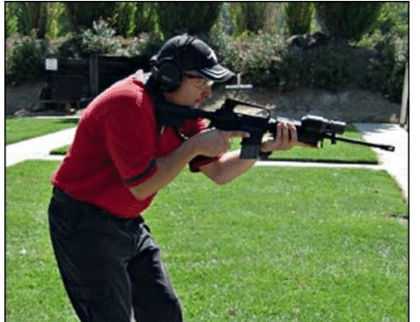
Firing Condition
Selector switch from SAFE to SEMI (Fire)
Only when the conscious decision to shoot has been made
Only when the sights are on target
Disciplined trigger finger management
Trigger finger rides high on the frame
Notes:
When moving to fire, remind students again of disciplined trigger finger management and riding high on the frame.

Slide 29
Loading
To Transport Condition
To Tactical Condition
Start clear and safe (3 point check)
Safety on SAFE
Bolt forward
Insert a full magazine. Do not chamber a round
Rifle is now in Transport condition
Start clear and safe (3 point check)
Safety on SAFE
Bolt forward
Insert a loaded magazine
Pull the bolt to the rear and release
Rifle is now in Tactical condition
Notes:
Knowing how to load the rifle is important. Knowing how to download and unload it safely is just as important.

Slide 30
Downloading the AR: Tactical Back to Transport
Rifle pointed in a safe direction, safety ON
Remove the loaded magazine and pocket it
Close the bolt on an empty chamber
1
6
Left palm under the magazine well, fingertips holding the port cover nearly closed
Load the round back into the pocketed magazine
2
7
Slowly draw the charging handle. The round drops into your left palm
Seat the magazine. DO NOT CYCLE THE ACTION
3
8
Left thumb presses the bolt lock to lock the bolt to the rear
Return the rifle to the vehicle storage device
4
9
Visually and physically check the weapon is unloaded
5
Unload only: stop after step 5
Notes:
Downloading returns a rifle in Fire or Tactical mode to Transport mode, most often after deploying without firing. Do it without ejecting rounds onto the ground or fumbling in front of the public. Work away from crowds and news cameras. In communities that question military style weapons, poor handling creates negative publicity. To UNLOAD completely, perform steps 1 through 5.

Slide 31
Transporting and Start of Shift Check
Department policy sets where and how the rifle is transported
Cruiser Ready (Transport) is recommended and most common
Know the storage mechanism and how to reach tactical mode
Check the rifle and equipment at the start of every shift
Never assume it is the way it is supposed to be
The check confirms good order and refreshes muscle memory
Know the condition of your rifle BEFORE you need it. Too many officers found out differently in a hurry.
Notes:
Policy states where the rifle rides, trunk or passenger compartment, and how: unloaded, cruiser ready, or another method. Knowing how to get the rifle from the storage mechanism into tactical mode is no different than knowing how to draw from your duty holster.

Slide 32
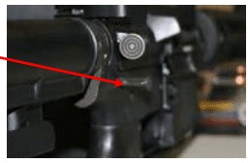
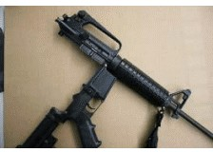
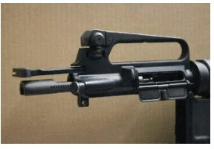
Field Stripping: Steps 1 to 3
CLEAR and SAFE the weapon with the 3 point safety check before you begin
1. Push the rear takedown pin out
2. Pivot the upper on the front pin
3. Slide out charging handle and bolt carrier
Notes:
First CLEAR and SAFE the weapon with the 3 point safety check. Takedown pins can be tight. In class a ballpoint pen works. In the field anything that pushes the pin from left to right will work.

Slide 33
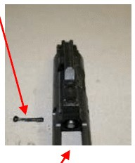
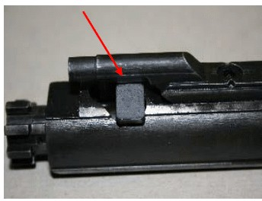
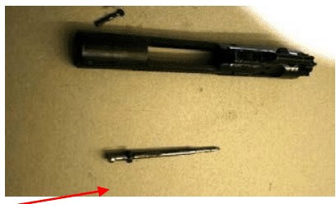
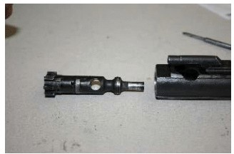
Field Stripping: Steps 4 to 7
4. Remove firing pin retaining pin
5. Remove the firing pin
6. Turn the cam pin 90° and remove
7. Pull the bolt from the carrier
The retaining pin is not a cotter pin. It sits flat and is not split into two halves.
Notes:
Remind students the firing pin retaining pin is not a cotter pin. Although it looks like one, it is meant to sit flat and is not split into two halves.

Slide 34
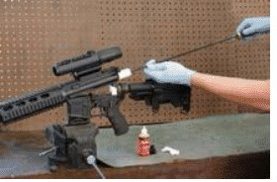
Cleaning Supplies and Equipment
Cleaning rod and guide
  Rod must match the rifle's caliber
  Guide keeps the rod centered from chamber to muzzle
  Always push through to the end. Never draw back with a patch or brush attached
  Remove the tip, draw the rod back, reattach and repeat until the patch is clean
Chamber brush is for the chamber only. Never push it through the barrel
  Only a standard copper bore brush runs out to the muzzle
Nylon toothbrush or bolt brushes for bolt carrier parts
Notes:
Most service weapon cleaning supplies work, with a few additions. The cleaning rod must match the caliber of the rifle. The bore brush is shaped for the chamber only and is NOT pushed completely through the barrel. Only a standard copper brush is run all the way to the muzzle.

Slide 35
Maintenance and Cleaning
Basic maintenance is the officer's responsibility under department policy and procedures
1
Put the weapon on SAFE and clear all live ammunition
2
Demonstrate the weapon is clear using the 3 point safety check
3
Field strip to basic components and explain each part's function
4
Clean, focusing on the rifle's areas of concern
5
Lubricate at the correct points using the correct procedure
6
Reassemble and perform a function check with dummy ammunition
Notes:
Remind students of the consequences of a poorly maintained weapon. Most patrol rifles are gas operated and are hit harder by poor maintenance. A rifle shot and put away dirty may not function months later. Clearing procedures must be taught before disassembly. Use the 3 point safety check.

Slide 36
Basic Rifle Function Check
1
2
3
Safety Check
Disconnector / Sear Check
Trigger Reset Check
Bolt in battery, selector on SAFE
Pull the trigger
Hammer must NOT fall
Pull trigger to drop hammer and hold it
Cycle the charging handle and release
Hammer must stay cocked
Repeat the check above
Slowly release the trigger
Listen and feel for a distinct metallic click
Safe, unloaded rifle. Muzzle in a safe direction. Dummy rounds or snap caps only.
Notes:
Perform anytime the weapon is reassembled, on a safe and unloaded rifle, only with dummy ammo. Snap caps are a good choice: letting the firing pin fall on some resistance helps the longevity of the parts. On semi auto AR style rifles the safety should NOT go to SAFE with the hammer down.

Slide 37




Four Types of Malfunctions
Failure to Feed
Failure to Fire
The cartridge did not move from the magazine to the chamber
Faulty ammunition or the firing mechanism failed to operate
Failure to Extract
Failure to Eject
The cartridge stays in the chamber after the action cycles
The cartridge stays in the receiver after leaving the chamber
Notes:
Every malfunction falls into one of the four phases of the cycle of operation. Students practice clearing these hands on in the Session 3 Group II station with dummy rounds.

Slide 38
Stoppages and Immediate Action
TYPE I
Simple Problem
TYPE II
Complex Problem
TYPE III
Broken Part
Unseated magazine or a dud round. You hear a click instead of a bang.
Tap, Rack, Evaluate failed. Most often a double feed.
Broken firing pin or extractor, or a case jammed in the chamber.
ACTION
Tap, Rack, Evaluate
ACTION
Transition to pistol, then clear
ACTION
Transition. Rifle is out of service
Notes:
Stoppages are classified as Phase I, II or III, also called Type I, II or III. When a stoppage occurs the shooter addresses it with an Immediate Action Procedure: a standard drill that quickly clears the problem and puts the weapon back into action. Fundamentals are the same as the semi auto pistol.

Slide 39
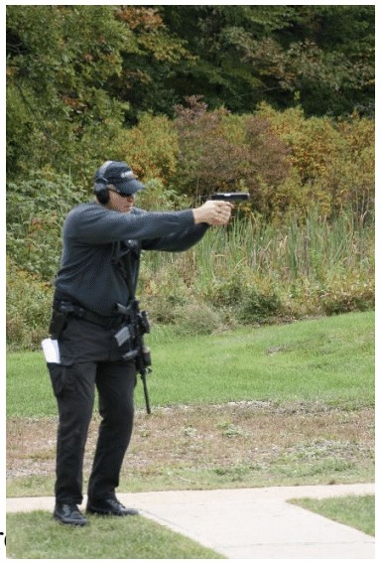
Type I: Tap, Rack, Evaluate
TAP
RACK
EVALUATE
TAP: strike the bottom of the magazine to seat it
RACK: pull the bolt fully to the rear and let it go forward under spring tension to chamber a round
EVALUATE: is deadly force still needed? Fire if necessary or continue to cover
Prevent it: Tap and Tug every magazine you insert
Notes:
Same protocol as the pistol. Prevent it by always checking the magazine after inserting it. Whether you call it Tap and Tug or Push and Pull, the concept is the same. Inspecting ammunition is the best way to minimize duds, but a perfect looking round sometimes will not fire.

Slide 40
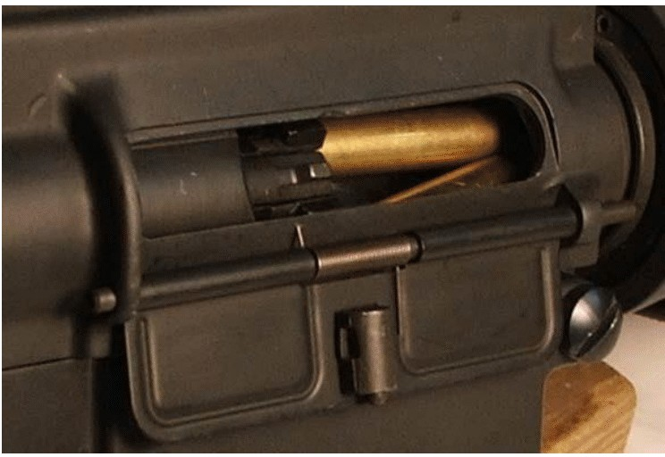
Recognizing a Double Feed
Most likely Type II malfunction you can fix in the field
More than one cartridge trying to chamber at once
Bolt is out of battery and partially open
No click when the trigger is pulled and the trigger feels mushy
Seek cover, then bring the rifle into your work space with the stock pulled into your body
Two rounds jammed at the ejection port
Notes:
With the patrol rifle, the most likely malfunction you can fix in the field is a double feed: more than one cartridge trying to chamber at the same time.

Slide 41
Clearing a Double Feed
1
2
3
4
TYPE I DRILL
LOOK
LOCK
RIP
Tap, Rack, Evaluate first
Confirm the double feed at the ejection port
Lock the bolt back to take pressure off the jam
Rip and retain the magazine
5
6
7
8
SHAKE
RELOAD
RELEASE
RE-ASSESS
Shake violently, clear brass if visible
Insert a fresh magazine
Release the bolt to chamber a round
Reassess the threat
Notes:
Always start with a Type I drill. If Tap, Rack, Evaluate does not fix it, look in the ejection port to confirm a double feed. Lock the bolt to the rear to take the pressure off the jam before touching the magazine. Rip the magazine out and retain it. Shake the rifle violently and clear any brass you can see. Reload with a fresh magazine, since the old one may be the cause. Release the bolt to chamber a round, then reassess the threat.

Slide 42
Type III: Broken Part
Typified by a broken part that stops the rifle from operating
Broken firing pin or extractor, or a case jammed in the chamber
Immediately transition to the service pistol and deal with the threat
Reassess your ability to engage in the current tactical situation
A strategic withdrawal may be the best course of action
Remember: anytime a malfunction cannot be immediately cleared, transition to the handgun.
Notes:
Possible causes include a broken firing pin or extractor, a case jammed in the chamber, or another broken part in the firing mechanism. None of these can be solved quickly.

Slide 43
Slings
Single Point
Two and Three Point
Recommended
Attaches near the grip or back of the receiver
Carried low, easily slung to the rear
Muzzle hangs down and can pick up debris
Shifts around and may damage sights or optics
Rifle carried in front of the body
Rests muzzle down when released
More complex and needs training time
Fine motor skills fade under stress
Simple two point jiffy or hasty sling for rifles shared by many officers
Rifle goes over the shoulder opposite the holster
Rests muzzle down, honoring the Cardinal Rules
Notes:
The sling does for the long gun what the holster does for the handgun. Without one, what do you do with the rifle when you transition, go hands on or climb a fence? Many tactical designs suit SWAT duties better. Under stress, the fine motor skills needed for straps and buckles may not exist. Complex slings can cost three times a simple jiffy sling.

Slide 44


Magazines, Illumination and Optics
Extra Magazines
Illumination
Optics
Highly recommended, as with the pistol
Load carrier vest (not ballistic)
Tactical vest pouches
Duty belt pouch for one 20 round magazine
Stock pouch, rarely seen
Weapon mounted light is valuable on a two handed tool
Usually mounted on the M1913 Picatinny rail
Position the switch so it is easy to use
Too many to list
Department policy decides which is best for your rifle
Notes:
Extra magazines and how they are carried are set by department policy and procedures. Stock pouches attached to the rifle are rarely seen today.

Slide 45
Practical
SESSION 3 OF 3
Hands on work: small group dry fire stations, then live fire positions, movement and the MPTC qualification course.
PART 1
Dry Fire Stations
PART 2
Fundamentals and Positions
PART 3
Movement and Cover
PART 4
Qualification
Notes:
Session 3 is hands on. Repeat the full safety brief before the dry fire stations and again before live fire.

Slide 46
Dry Fire and Manipulations
SESSION 3 | DRY FIRE STATIONS
The class breaks into small groups at safe areas for dry fire drills. Every classroom safety protocol applies again, and every student performs a 3 point safety check before any dry drill.
GROUP I
Unloading and conditions of carry
GROUP II
Malfunction clearing, transitions and support side
GROUP III
Field stripping, cleaning and function check
Notes:
Repeat all nine classroom safety protocols before the groups begin: chamber flags, cased and locked rifles, safety personnel in vests, live ammunition checks on students and instructors, one way in and out, Incident Action Plan, signed rules, and designated loading and unloading areas.

Slide 47
Group I: Unloading with the 3 Point Check
1
Remove the magazine
“Magazines Out”
2
Lock the bolt to the rear
3
3 point check: chamber, ejection port, magazine well
“Look and Feel”
4
Cycle the bolt 3 times
“Working parts to the rear three times”
5
Close the bolt
6
Ensure the safety is ON
“Safety On”
7
Recover any ejected round when told by the range master
“Pick up anything you dropped”
Notes:
Performed in the classroom with dummy rounds and many repetitions. This is the same 3 Point Safety Check taught in Session 2. Keep the muzzle in a safe direction throughout. Students say the verbal cues out loud.

Slide 48
Group I: Conditions of Carry Drills
SAFE
TRANSPORT
TACTICAL
FIRE
Remove magazine
Lock bolt, 3 point check
Cycle bolt 3x, close it
Safety ON
Start clear and safe
Bolt closed, chamber empty
Insert full magazine (dummy)
Do NOT chamber a round
Still on safe, double check
Cycle the bolt
High index trigger finger
Muzzle safe direction
Selector to semi
Decision to fire made
Sights on target
Finger discipline
Notes:
Same procedures taught in the classroom, now performed hands on by every student with dummy rounds and repeated reps. Every student performs the 3 Point Safety Check before the dry drills start.

Slide 49
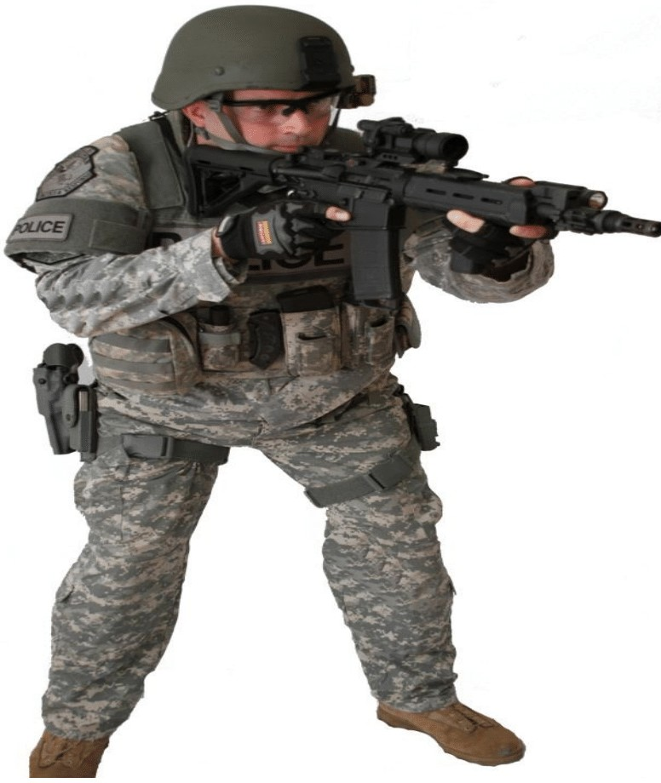
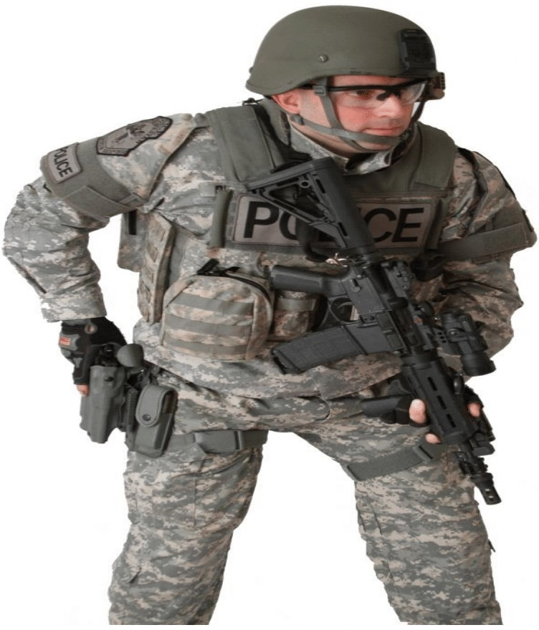
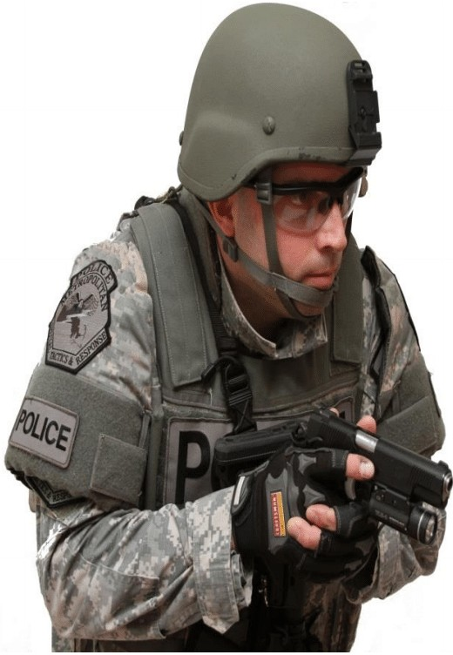
Group II: Transition to the Pistol
1. Try for safe. Guide rifle down
2. Draw and orient to the threat
3. Two handed grip at the body
Attempt to rotate the selector to safe (it may not go). Guide the rifle down with the support hand while the strong hand gets a high tang grip in the holster. Disengage all holster safeties.
Notes:
Tap, Rack, Evaluate has failed. Immediately transition to the service pistol and address the threat. Once the threat is handled or you are behind good cover, assess the cause of the malfunction.

Slide 50
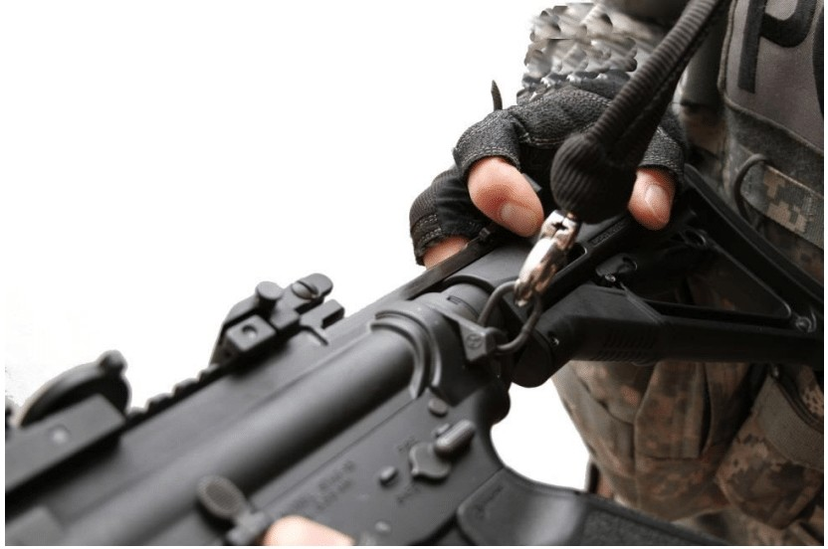
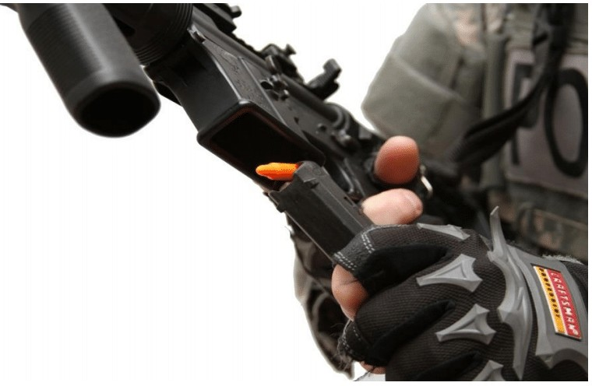
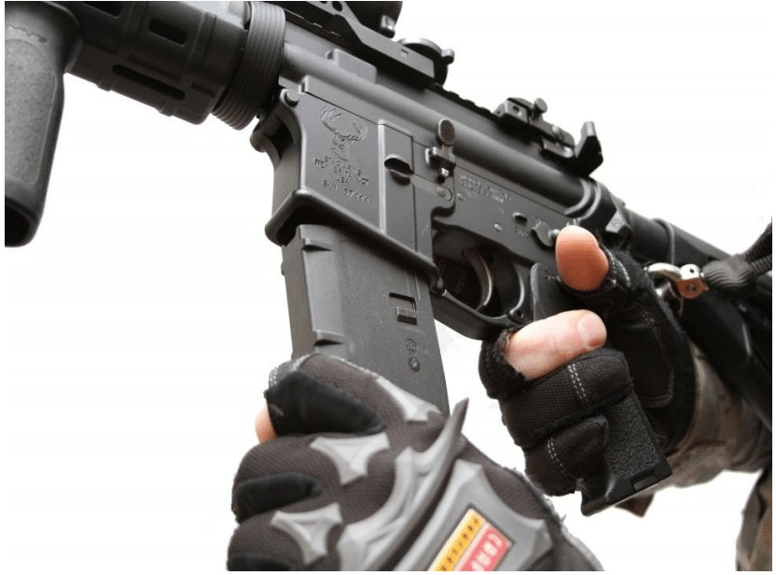
Group II: Double Feed Clearance Drill
Lock the bolt to the rear
Rip and retain the magazine
Inspect the chamber
Insert a fresh magazine
Lock the bolt BEFORE ripping the magazine. Locking it takes the pressure off the jam so the magazine comes free.
Notes:
Run the full sequence with dummy rounds: Type I drill, look, lock the bolt to take pressure off the jam, rip and retain the magazine, shake violently and clear visible brass, reload a fresh magazine, release the bolt, reassess. Lock the bolt before ripping the magazine. Otherwise upward pressure from the magazine on the bolt may keep the magazine from coming out.

Slide 51
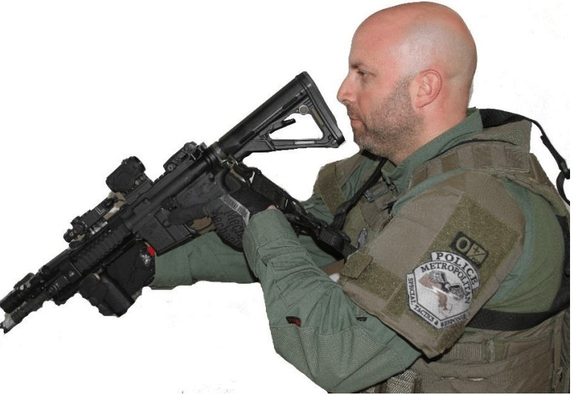
Group II: Support Side, Single Point Sling
Why switch sides? Better cover, an injury to your weapon side, or it is the only view you have of the target.
1
Strong hand grasps the magazine well
2
Support hand moves to the grip
3
Strong hand moves to the handguard or forward grip
4
Push rifle out, lift the stock over the sling
5
Stock into the support shoulder. Switch feet
Notes:
Note: when shooting from the support side you may use the support side thumb to move the selector from safe to fire, and the support side trigger finger to move it back to safe.

Slide 52
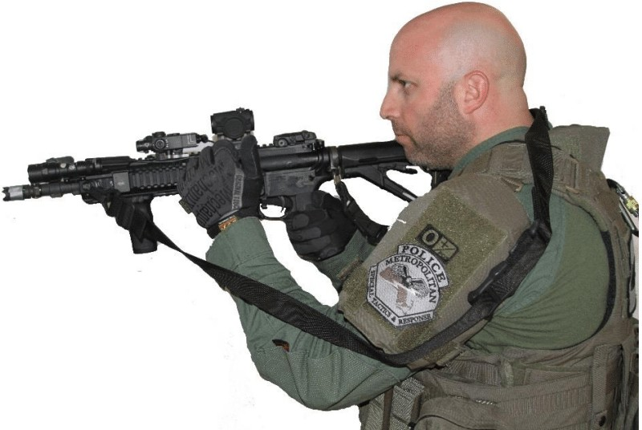
Group II: Support Side, Two Point Sling
Before deploying, loosen the sling so the arm moves freely in and out
Bring the support arm in and down between rifle and sling. Sling is now behind the neck only
1
Strong hand grasps the magazine well
2
Support hand moves to the grip
3
Strong hand to the handguard. Push out, lift stock over the sling
4
Stock into the support shoulder. Switch feet
5
Notes:
Before deploying to an objective or shooting, make sure the sling is loose enough for the arm to move freely in and out of it.

Slide 53
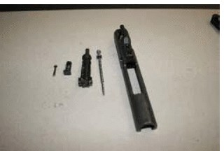
Group III: Field Stripping and Cleaning
Clear and safe the weapon with the 3 point safety check
Field strip in the 7 steps covered in Session 2
Explain each major component and its function as it comes apart
Clean the areas of concern and lubricate correctly
Reassemble and perform the 3 part function check with dummy rounds
Review the cycle: Feed, Fire, Extract, Eject
Notes:
Group III performs hands on field stripping, cleaning, lubrication, reassembly, the function check and the cycle of operation review covered in Sessions 1 and 2. Clearing procedures must be taught before disassembly.

Slide 54
Live Fire: Range Zeroing and Marksmanship
SESSION 3 | LIVE FIRE
Fundamentals, ready positions and firing positions from standing to prone, then movement, cover and qualification.

Slide 55
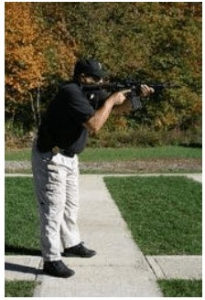
Shooting Fundamentals
Support Hand
Strong Hand
Clear of the magazine well. Elbow tucked in
Grips the pistol grip. Trigger finger along the receiver
Strong Elbow
Butt Stock
Down and tucked into the body for support
High on the shoulder with the toe high. Keeps the head up
Cheek Weld
Breathing
Maintains consistent eye relief
Breathe, Shoot, Scan, Breathe
Notes:
Relaxed body drill: bring the rifle up to the ready position, close your eyes, relax, then open them. That reveals your natural point of aim.

Slide 56
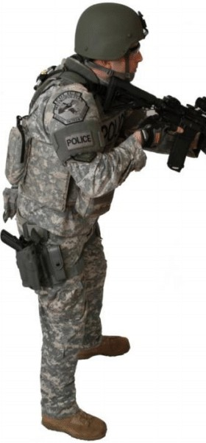
Low Ready and High Ready
Low Ready
High Ready
Muzzle down at about 45 degrees
Threat stays visible over the sights
Supports Cardinal Rule 2
Raise the muzzle slightly to engage
Hands on grip and handguard
Stock slightly under the armpit
Rifle just below the line of sight
Full view of the threat area
Drive out and pull into the shoulder
Notes:
Low ready: avoid obscuring the threat with the sights and barrel, keeping you in compliance with Cardinal Rule 2. Muzzle points at the ground at about 45 degrees. If deadly force becomes necessary you only need to raise the muzzle slightly.

Slide 57
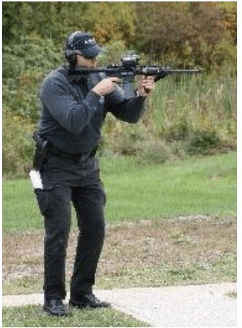
Standing
Most used position. Best balance of mobility and stability
Square to the target to get the most from body armor
Knees flexed, weight forward, leaning into the shot
Pivot 180 degrees on the feet and 90 degrees at the waist
Elbows in to the torso for added stability
Can be static or on the move
Notes:
The long gun is heavier and is a two handed weapon, so the classic shooting stance is not the most effective technique for tactical shooters. The offhand position can be static or dynamic, on the move.

Slide 58
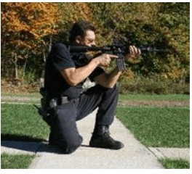
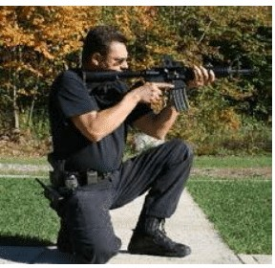
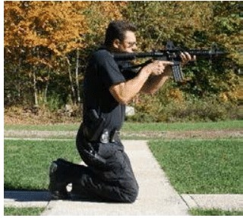
Kneeling: Three Variations
Brace Kneeling
Speed Kneeling
California Kneeling
Classic position. Support elbow against the side of the leg or triceps on the knee. Avoid bone to bone contact
Drop straight down. Arms do not touch the legs. Upper body stays in the standing position
Both knees down, no arm to leg support. Can lean back to lower the profile over cover
Notes:
Kneeling lets the shooter get lower to use low cover while still letting the torso pivot to engage targets to the side. For brace kneeling, a right handed shooter puts the right knee down.

Slide 59
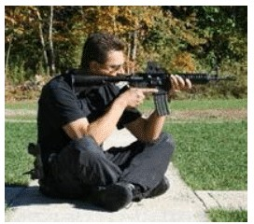
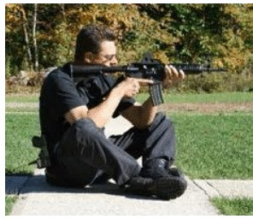
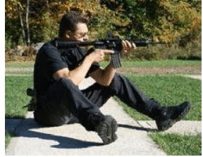
Sitting Positions
Cross Leg
Cross Ankle
Open Leg
Legs extended and slightly bent, left over right. Elbows just behind the knees inside the thigh
Cross at the ankles and tuck them under you. Left hand just forward of the chamber
Legs extended, heels dug in. Elbows inside the thighs just below the knee
Notes:
For a right handed shooter, sit with the body pointing about 30 degrees right of the target. Sitting can be very stable but offers little mobility.

Slide 60
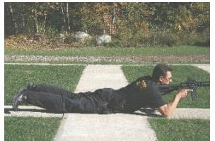
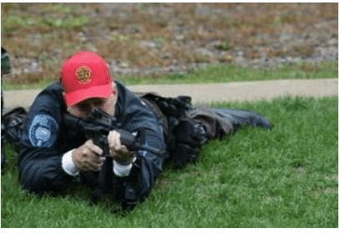
Prone
Most stable of the unsupported positions. Used behind or around low cover
Takes more time to get into. Shooter cannot move as quickly
Body points 10 to 20 degrees right of the target
Shoulders square with the spine, weight on the left side
Left leg straight, right leg drawn up as if crawling
Left hand forward cradling the rifle. Right elbow slightly out, on the ground
Head level. Rifle snug in the shoulder pocket with a solid cheek weld
Notes:
Describe for a right handed shooter. Reverse for left handed shooters.

Slide 61
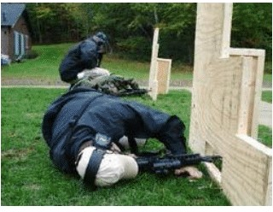
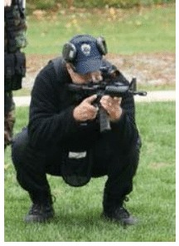
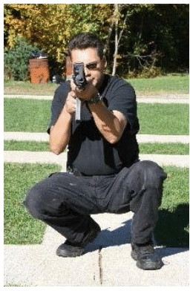
Rollover Prone and Squatting
Rollover Prone
Squatting (Secondary)
Shoot from under vehicles or through openings too tight for standard prone
Iron sight line is about 2 inches above the muzzle. Roll to the side to use the sights
Less stable. Only two narrow ground contact points, the feet
Practice it for ground with undesirable qualities
Notes:
Squatting is a secondary position. Practice it for ground with undesirable qualities. Squat facing 20 to 30 degrees right of the target, feet about shoulder width, knees slightly out, body inclined slightly forward.

Slide 62
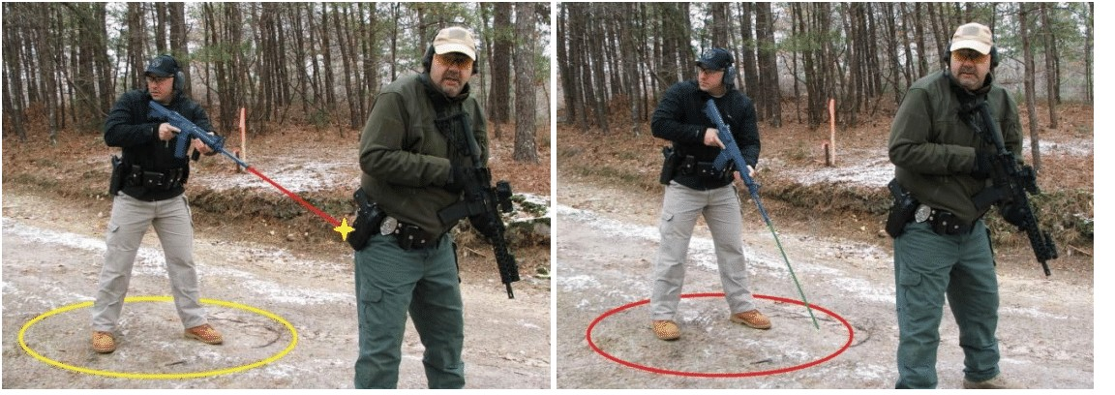
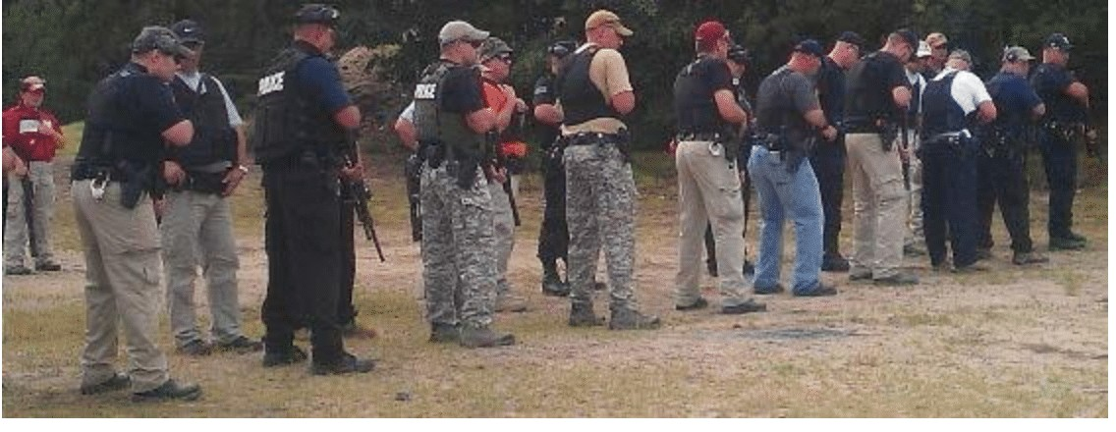
The Safety Circle
A crowded line needs a smaller circle
Maintain a muzzle depressed position, pointed at the ground just in front of your feet
Picture yourself in the center of a circle
The muzzle stays inside the circle until you face the threat
The more crowded the line, the smaller the circle
Notes:
Even a little muzzle drift during pivots and turns can point the rifle at the person in front of or next to you. Keep the muzzle within your circle until you face the target and are ready to bring it up. The more crowded the line, the smaller the safety circle.

Slide 63
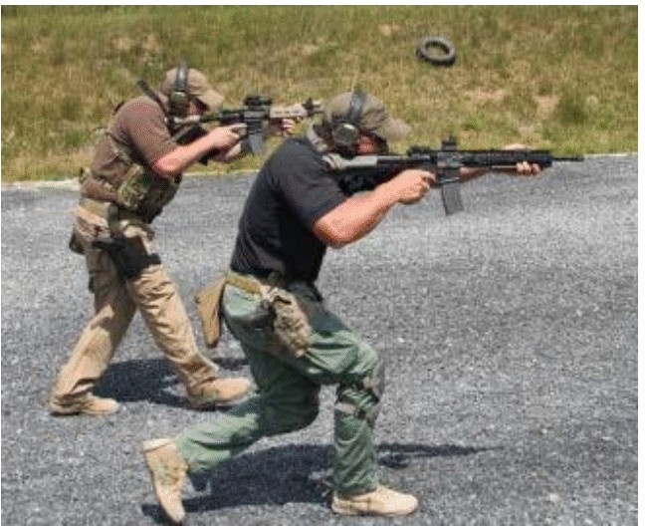
Shooting on the Move
Advance
Lateral
Bent knee walk. Knees absorb each step to stop front sight bounce. Shuffle step on uneven ground
Never cross the feet. Bring feet together and side step. Turn and advance if speed is needed
Bent knees stabilize the muzzle
Withdraw
Bent knee, drag the toe to avoid tripping
Clear the fatal funnel quickly
Notes:
On the range during MPTC training the command “Advance” starts forward movement and “Withdraw” starts rearward movement. The longer rifle barrel accentuates sight bounce more than a pistol. On uneven terrain the shooter can fall back to the shuffle step. Move quickly through the fatal funnel, any doorway, hallway or bottleneck, to a position of advantage.

Slide 64
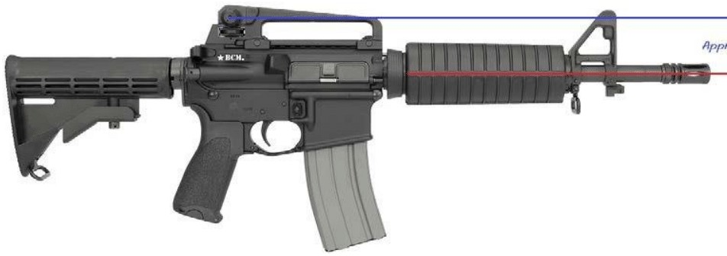
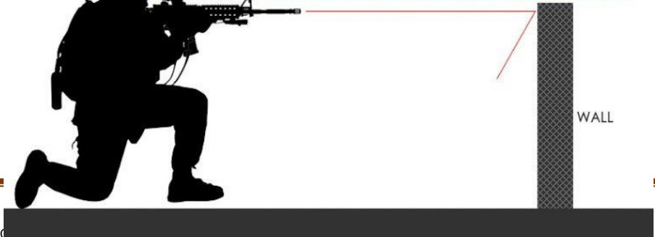
AR Sight Offset
2.5″
Standard iron sights sit about 2.5 inches above the bore axis
The sights can clear cover while the bullet path does not
Result: a missed shot and possible injury to the shooter
Know your offset for close range head shots
Notes:
A design trait of the AR series is a large offset between the bore axis and the sight axis. Some rifles have an even larger offset. While the target is clearly seen in the sights, the bullet path may be blocked by cover, causing a missed shot and possible injury to the shooter.

Slide 65
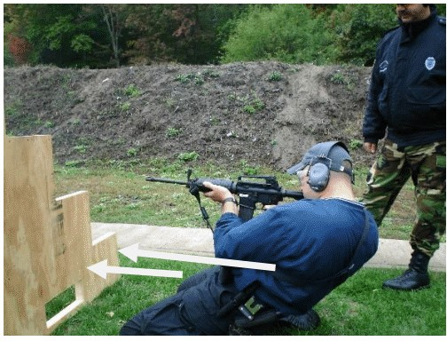
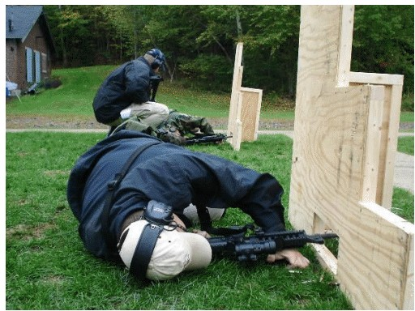
Shooting from Cover
Offset next to cover
Support side from cover
Notes:
Apply the sight offset when shooting from behind cover. Practice offset next to cover and support side shooting from cover.

Slide 66
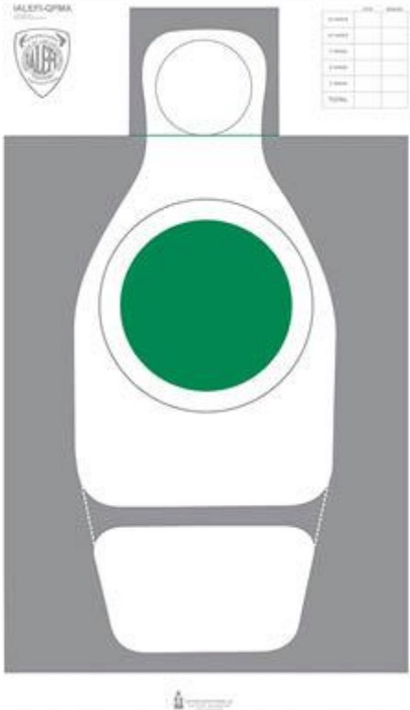
Qualification Standards
90%
94%
Passing score for officers
Passing score for instructors
Officers
Instructors
100% round accountability anywhere on the target
Miss no more than 3 at 50 yd and 2 at 25 yd
100% of rounds must be in the gray box
Miss no more than 3 between 50 and 25 yd
Notes:
Instructors: if a round is outside the gray box it is a fail. Officers: 100% round accountability anywhere on the target.

Slide 67
Course of Fire
Yard Line | Rounds | Drill | Minimum Hits
50 | 10 | Position of choice, no time limit | 7 of 10
25 | 12 | Advance from 30. 6 kneeling, then 3 strings of 2 standing | 10 of 12
15 | 3 | Head shot, 1 round x 3. Know your offset | 3 head shots
10 | 4 | Hammer drill, 2 rounds x 2 standing | 4 of 4
7 | 6 | Look, pivot and turn: left, right, rear. 2 each | 6 of 6
5 | 9 | Failure drill, 2 body + 1 head x 3 | 9 (incl. 3 head)
7 to 3 moving | 6 | Failure drill on the move x 2 | 6 (incl. 2 head)
Notes:
50 yard line: rifles should be zeroed here, point of aim equals point of impact. Explain prone is the most stable platform. 25 yard: start at the 30, advance on command. 15 yard head shots simulate a suspect behind cover with the neck not exposed. Shooter must know their offset and hit above the line. 10 yard: hammer drill, get rounds off quickly. 7 yard: look, pivot and turn left, right and rear. Stress muzzle discipline. 5 yard and moving: failure drills, two quick body shots then take the second for the head shot.

Slide 68

Safety First, Every Time
KEY TAKEAWAYS
Treat every weapon as loaded
Off target, off trigger
Tap, Rack, Evaluate. Transition when it fails
Know your rifle's condition before you need it
Notes:
Close by reinforcing the Cardinal Rules and the core habits from the day, then answer questions.

